Slide 1
Practice Lab:
This Practice Lab is dependent on Discussion Unit 6250, where most of the objects we create in this lab were introduced.
In this Practice Lab, we install Ops Center, the Ops Center agent, and call to manage an existing cluster.
Install DSE Ops Center, Call to Manage Existing Cluster
Notes:
The goal of this Practice Lab is to install and use DSE Ops Center.

Slide 2

Challenge: Overview
Prerequisites:
Instructions are provided for Linux
We will operate below recommended settings; 1 OS node only, minimum 8 GB RAM, 12 GB RAM preferred
Challenges 1-4:
Make a single node DSE cluster with a real IP address
Manually install the Ops Center agent
Install Ops Center
Tell Ops Center to manage the DSE cluster above
Notes:
To complete this Practice Lab, the following is assumed:
All prerequisites and conditions as listed above.
All work is expected to be executed on one OS node (instructions are written for Linux).
Because of resource constraints, it is expected you are running a single DSE Core node (no Graph, Spark, Search) on this single OS node.

Slide 3
Challenge 1: Single node DSE with real IP addr
Edits given IP addr of 172.16.119.194
cassandra.yaml
- seeds: "172.16.119.194"
listen_address: 172.16.119.194
native_transport_address:
172.16.119.194
cassandra-env.sh
MAX_HEAP_SIZE="2048M"
HEAP_NEWSIZE="200M"
JMX_PORT="7499"
dse cassandra –f -R
Leverage lab instructions from 6207, Keyspace Lab
Make certain hostname resolves
ping `hostname`
ifconfig (or Google how)
vi /etc/hosts
Ensure firewall is disabled
(CentOs 7 below, or Google)
systemctl disable firewalld
Notes:
For Challenge 1, create a single node DSE cluster with a real IP address.
Start your DSE cluster when all other steps above are complete.

Slide 4
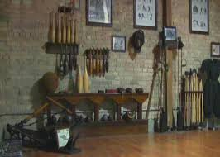
Challenge 2: Ops Center Agent (manual install)
Ops Center can install its agent automatically
But, manual install today because ..
-- Run agent in foreground,
easier diagnostics
-- This is an odd install, multiple
entities may try to take
localhost/127.0.0.1, better
control via manual install
Notes:
For Challenge 2, manually install the Ops Center agent. Comments:
Normally this is a task we ask Ops Center to perform automatically.
We are performing this task manually because of the odd nature of this install; multiple servers, other, operating on one host.
Also, running the agent in the foreground gives us easy/immediate feedback should the agent fail to start.

Slide 5
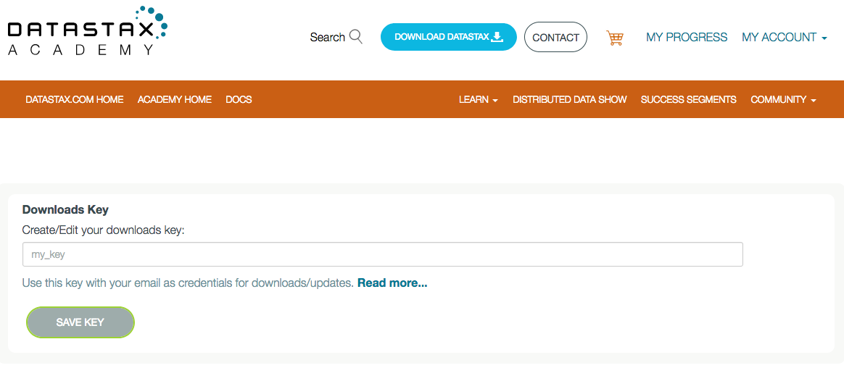
Challenge 2: Ops Center Agent (manual install)
Create a download key from,
https://academy.datastax.com/downloads
Value used on next page
Notes:
There isn't a direct download (a Web page, link) of the Ops Center agent per se. Instead, you run a specific curl(C) command. As such, you need to create a "download key" from https://academy.datastax.com/downloads
Reference Urls,
https://docs.datastax.com/en/install/doc/install/opscManualAgentInstalls.html
Tarball install of agent
https://docs.datastax.com/en/install/doc/install/opscagentInstallManual.html

Slide 6
Challenge 2: Ops Center Agent (manual install)
mkdir /opt/ops_center_agent
cd /opt/ops_center_agent
Download agent via,
curl --user your_name@aol.com:your_key -L \
ht tp://downloads.datastax.com/enterprise/datastax-agent-6.5.0.tar.gz \
| tar xz
Wrong version (6.5.0) other ?
gzip: stdin: not in gzip format
tar: Child returned status 1
tar: Error is not recoverable: exiting now
Notes:
The Ops Center agent is a 16MB download. Create a directory and change into same. Download the agent via the curl(C) command shown.
The address given to curl will change with versions of the agent and Ops Center proper. Displayed is version 6.5.0 of DSE Ops Center.

Slide 7

Challenge 2: Ops Center Agent (manual install)
The previous command outputs files-
cd /opt/ops_center_agent/conf
vi ./conf/address.yaml
stomp_interface: 127.0.0.1
use_ssl: 0
cd ../bin
./datastax-agent -f
Notes:
Starting the Ops Center agent in the foreground.
Initially Ops Center server will not be functioning, and the agent will display period errors. These will clear when Ops Center is up and running.
Relative to the Ops Center agent conf/address.yaml file:
The IP address tells the agent where to find Ops Center. We will be running Ops Center on 127.0.0.1
And whether to use SSL; we are not.

Slide 8
Challenge 3: Ops Center install
mkdir /opt/ops_center
cd /opt/ops_center
Download Ops Center 6.5.0 from,
https://academy.datastax.com/quick-downloads
(Version 6.5.0 instructions here.)
./bin/opscenter -f
http://localhost:8888/
Answers on both localhost and (actual IP addr)
Notes:
The Ops Center download is a 290MB Tar ball. Unpack in the directory listed above.
The ./bin/opscenter command starts the Ops Center Web server (Web application). This application does take a few moments to start.
Reference Urls,
https://docs.datastax.com/en/opscenter/6.5/index.html
https://docs.datastax.com/en/install/doc/install/opscInstallOpsc.html

Slide 9
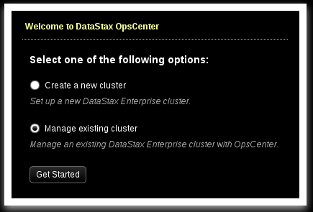
Challenge 4: Ops Center, First steps
As a first time boot of Ops Center, you receive the modal dialog box shown at left-
Choose (existing), and Click, Get Started
Notes:
As a first time boot of Ops Center, the modal dialog box displayed above is received. Choose (existing).

Slide 10
Challenge 4:
Enter the IP address and JMX port number of the existing DSE cluster we created in Challenge 1.
No security, leave these
Click, Next
Notes:
Enter the IP address of the DSE cluster we created in Challenge 1, and the correct JMX port number.
We aren't using security; leaves these visual controls untouched.
Click, Next.

Slide 11
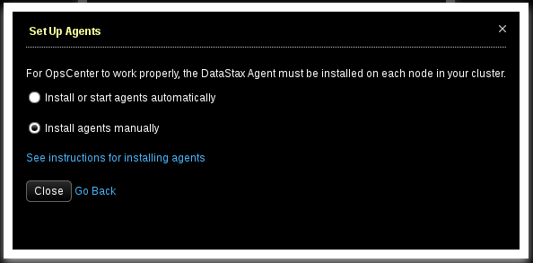
Challenge 4:
Check, Install Agents Manually, then Click Close.
Notes:
As the Ops Center agent is already installed and booted, Check "Install Agents Manually", and Click Close.

Slide 12
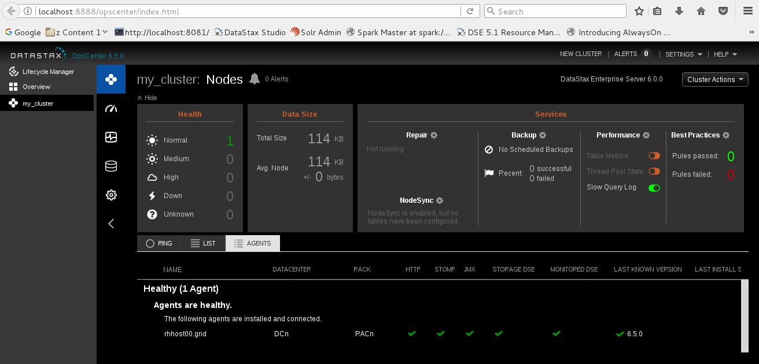
Challenges 1-4: Success
Notes:
Success; the main display inside DSE Ops Center.

Slide 13

Practice Lab:
Lessons Learned
Notes:
Discuss what worked well, poorly, from the Practice Lab.

Slide 14
Notes:
End of Practice Lab-

